Slide 1
Kotlin

Slide 2
Topics
Kotlin – the Language
Variables
Data Types
Operators

Slide 3

Kotlin
The language we speak to the computer!
What we are going to be using for this module.
Java, but easier to read.

Slide 4
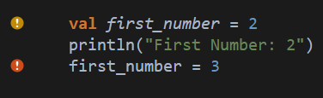

Variables
val – Can store any kind of data, however, it can only be set once!
If you try and change the value, you’ll get an error.

Slide 5
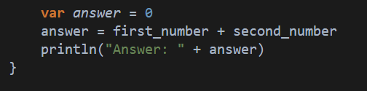
Variables, CONT.
var – Can also store any type of data, but this time, can be changed!

Slide 6
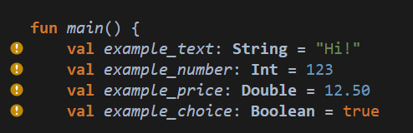
Variables, CONT.
Types
Variables can also be set to a certain type, meaning they can only store a specific kind of data
Type | Explanation | Example
String | Text data | “Hello!”
Int | Numbers, with NO decimals | 123
Double | Numbers, WITH decimals | 12.50
Boolean | True or False | True
Any many more we will learn about as the semester continues!

Slide 7
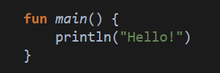
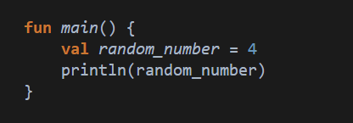
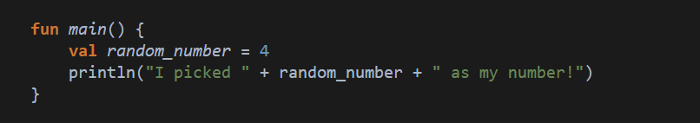
Output
When outputting, we will use println() (And later, Log)
Between the brackets, we need to give it what we want to show
We can also output information from variables

Slide 8
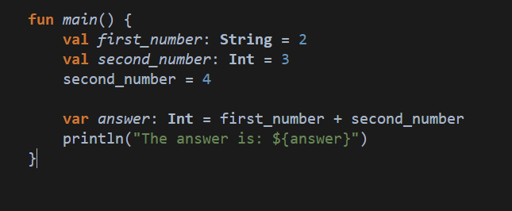
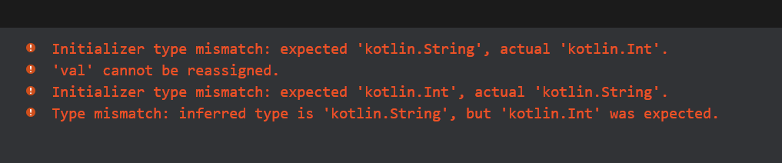
Spot the Issues!
This must be Int to store a number!
Variables of type “val” cannot be changed!
The answer never needs to change, so it should be “val”!
Unhappy computer!

Slide 9
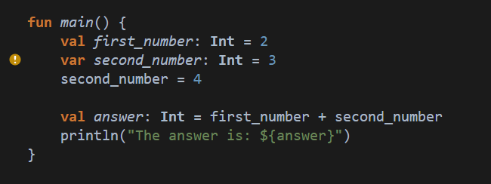
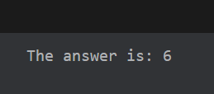
How it should look…
Much better!

Slide 10
Lets Try!
https://play.kotlinlang.org/

Slide 11
What I want you to do…
Write code that stores the length and width of a rectangle (you can choose the sizes) in variables.
Using these variables, calculate:
The perimeter (2 * length + 2 * width)
The area (length * width)
Print out the answers to these calculations.

Slide 12
Second Example
Write a small program for your local gym to help calculate the BMI of users.
You need the weight in kilograms (kg), and height in metres.
The calculation for BMI is weight/height^2
(weight divided by height squared)

